Slide 1
Agile
Agile is a collaborative and iterative approach to project management and product development that prioritizes flexibility, customer feedback, and incremental progress.

Slide 2
Agile Principles
Highlight key Agile principles, such as:
Customer Collaboration over Contract Negotiation
Individuals and Interactions over Processes and Tools
Working Solutions over Comprehensive Documentation
Responding to Change over Following a Plan

Slide 3
Agile Frameworks
Briefly introduce popular Agile frameworks: Scrum
Kanban
Lean
Extreme Programming (XP)
Agile Hybrid Models (e.g., SAFe, LeSS)

Slide 4
Agile Benefits
List the advantages of Agile, such as:
Faster Time to Market
Enhanced Product Quality
Improved Customer Satisfaction
Greater Team Collaboration
Better Adaptation to Change

Slide 5
Agile Implementation
Explain how to implement Agile:
Start with Agile Training
Form Cross-Functional Teams
Define Clear Roles and Responsibilities
Develop a Backlog and Prioritize Tasks
Hold Regular Iterative Meetings (e.g., Sprint Planning, Daily Standups)

Slide 6
Agile in Action
Share a brief case study or example of Agile in action. Describe a real-world project or scenario that benefited from Agile practices.
Agile Tools
Mention some popular Agile tools for project management and collaboration, e.g., Jira, Trello, Asana, or any tools your organization uses.

Slide 7
Conclusion
Summarize the key takeaways:
Agile is a flexible and customer-focused approach to project management.
It relies on iterative development and continuous feedback.
Agile offers numerous benefits, including faster delivery and improved quality.
Implementation involves training, team formation, and regular meetings.

Slide 8
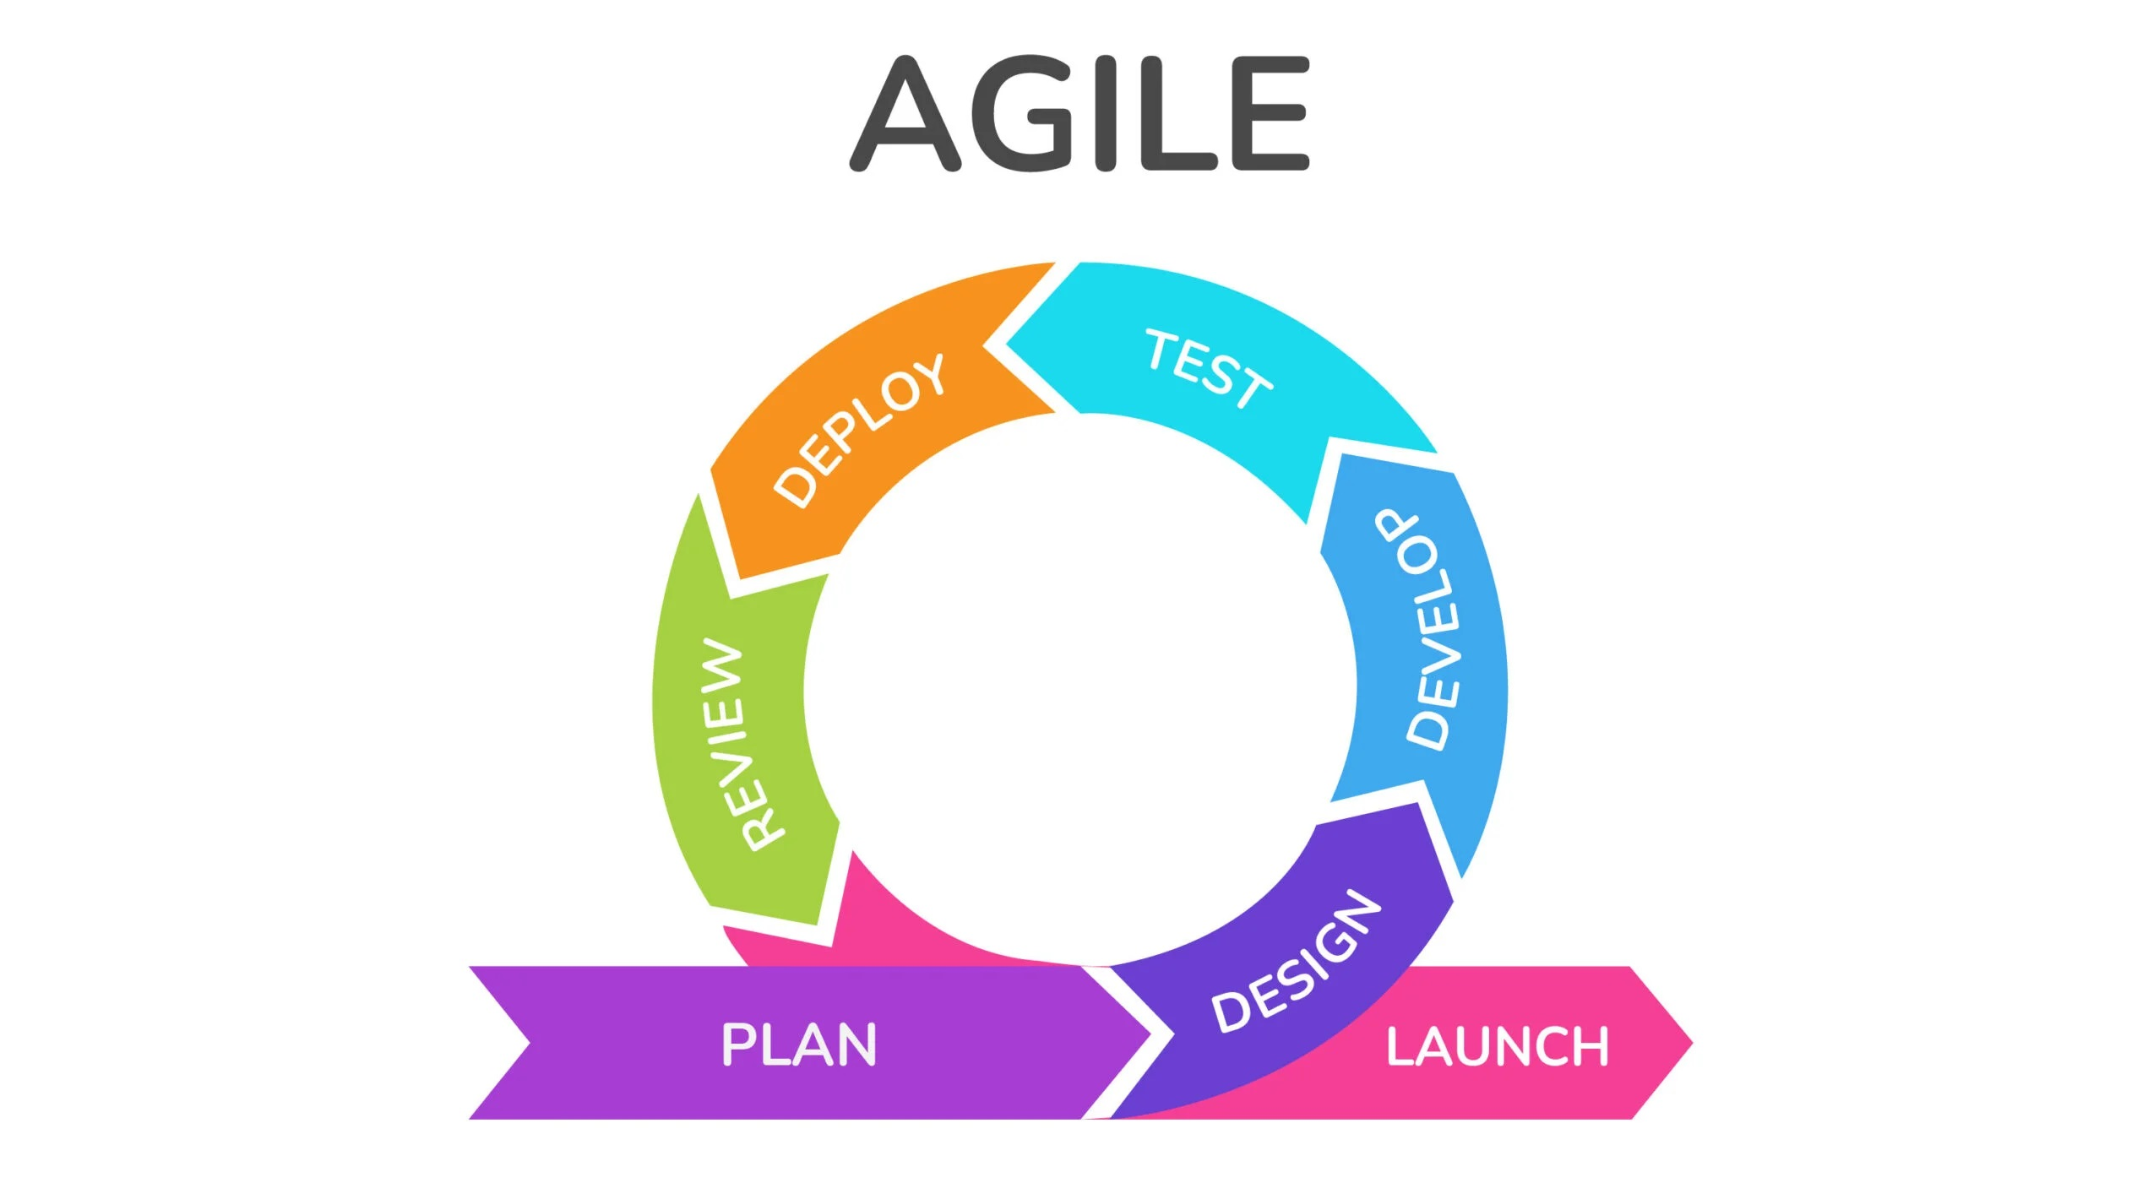
.

Slide 9
waterfalls model
The Waterfall Model is a linear and sequential project management approach in which progress flows in one direction, similar to a waterfall, with each phase dependent on the deliverables of the previous phase.

Slide 10
Key Principles
Highlight the fundamental principles:
Strict Phase Dependencies
Comprehensive Documentation
Minimal Customer Involvement During Development
Well-defined Requirements Upfront

Slide 11
Phases of the Waterfall Model
Break down the typical phases:
Requirements Gathering
System Design
Implementation
Integration and Testing
Deployment
Maintenance and Support

Slide 12
Pros of the Waterfall Model
List the advantages, including:
Clear and Well-Defined Project Scope
Predictable Timeline and Budget
Comprehensive Documentation
Well-structured Development Process

Slide 13
When to Use Waterfall
Explain situations when the Waterfall Model is suitable, e.g.:
Well-understood and stable requirements
Minimal customer involvement is acceptable
Low-risk projects with clear scope

Slide 14
Conclusion
Summarize the key takeaways:
Waterfall is a sequential, document-driven approach.
It's best suited for projects with stable requirements.
Waterfall has both advantages and disadvantages.
Consider project context when choosing the right methodology.

Slide 15
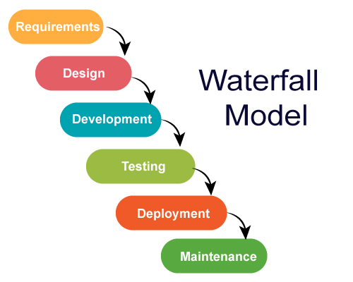
.

Slide 16
Thank you…

